Slide 1

What Influences Marathon Performance? A Statistical Analysis of Boston Marathon Data
Jada Norris, Olivia Overholt, Carson Cochrane, AnnCathrine Beissel

Slide 2
Predicting Marathon Finish Times Using Regression
Using a sample of 200 runners, what is the estimated finish time for runners whose half marathon split in 62 minutes?
Why 62 minutes?
The fastest half splits in the first 200 runners are around 1 hour 2 minutes (≈62 minutes).
The slowest half splits in that group are closer to 1 hour 16 minutes (≈76 minutes).
Most elite runners in the first 200 finishers hit the halfway mark between 1:02 and 1:14.

Slide 3
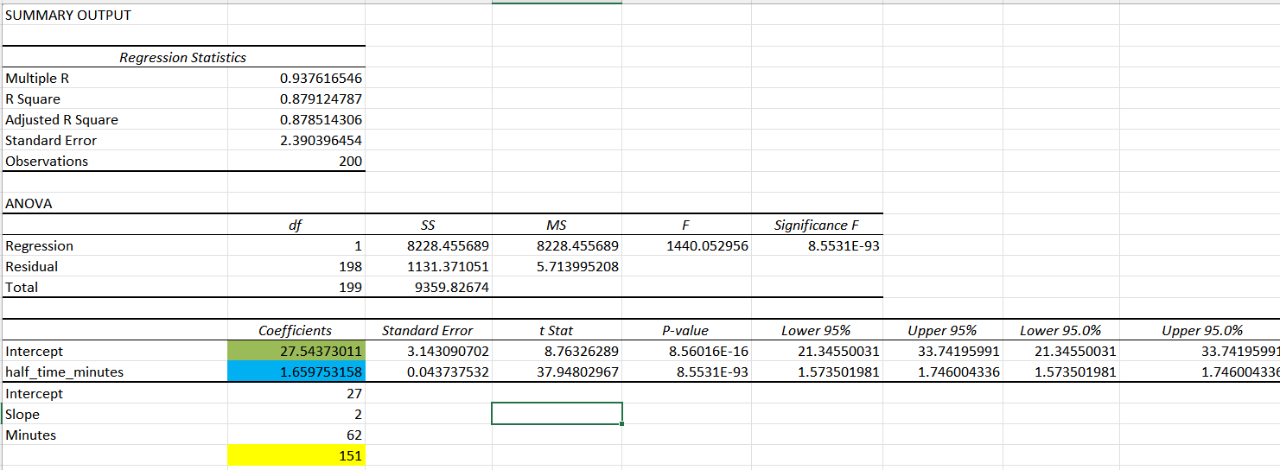
Method and Calculation

Slide 4
Why this matters?
Real time pacing decisions.
Goal setting strategy.
Performance analysis.

Slide 5
How Age and Gender Influence Marathon Pacing Efficiency
How does age modify the relationship between half-marathon time and full-marathon finish time, and does this effect differ between men and women?
Data: 13,152 Boston Marathon runners
Variables analyzed:
Half time (min)
Full time (min)
Age group (18-34, 45-49, 50-54)
Gender
Method: Boxplots + Scatterplot + Multiple Regression

Slide 6
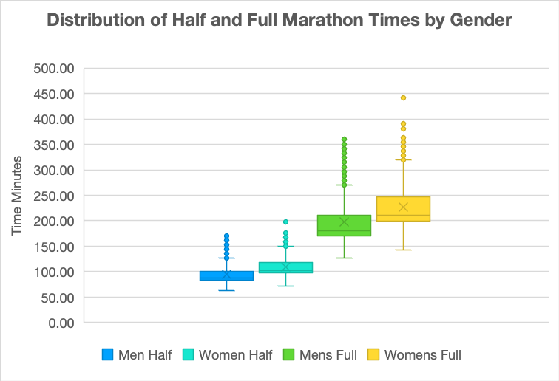
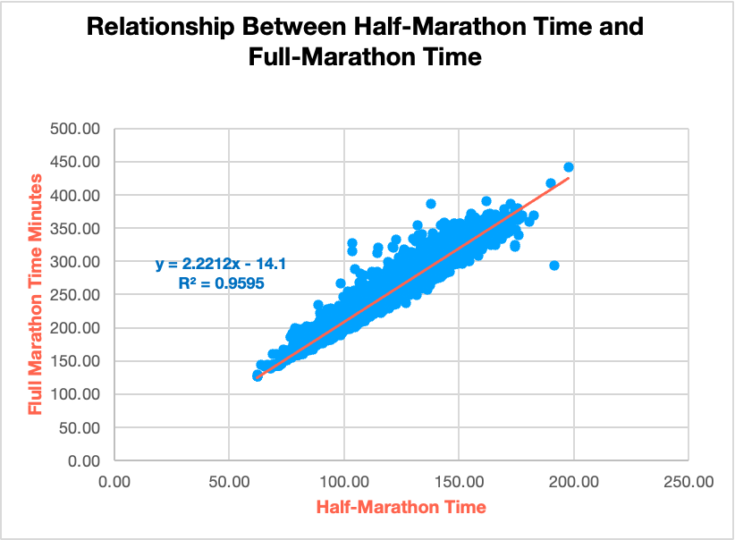
Visualizing Half & Full Marathon Times
Half time strongly predicts full time
Men and women pacing distributions overlap
No major gender differences in pacing
Tight linear trend between half and full marathon times

Slide 7
Regression Findings & What They Tell Us
Regression Statistics
Multiple R | 0.97995419
R Square | 0.96031021
Adjusted R Square | 0.96029511
Standard Error | 8.91963891
Observations | 13152
ANOVA
 | df | SS | MS | F | Significance F
Regression | 5 | 25305846.5 | 5061169.29 | 63614.5292 | 0
Residual | 13146 | 1045895.21 | 79.5599583
Total | 13151 | 26351741.7
 | Coefficients | Standard Error | t Stat | P-value | Lower 95% | Upper 95% | Lower 95.0% | Upper 95.0%
Intercept | -15.325006 | 1.78549322 | -8.5830658 | 1.0267E-17 | -18.82483 | -11.825181 | -18.82483 | -11.825181
Gender Dummy | 1.48051121 | 0.9895091 | 1.49620778 | 0.13462352 | -0.4590696 | 3.42009198 | -0.4590696 | 3.42009198
age_mid | -0.1018859 | 0.0469689 | -2.1692207 | 0.03008379 | -0.1939517 | -0.0098201 | -0.1939517 | -0.0098201
half_age | 0.00047799 | 0.00042395 | 1.12746876 | 0.25956492 | -0.000353 | 0.001309 | -0.000353 | 0.001309
half_gender | 0.01456961 | 0.00931125 | 1.56473207 | 0.11766982 | -0.0036818 | 0.03282101 | -0.0036818 | 0.03282101
Half Time Min | 2.2383109 | 0.01642657 | 136.261617 | 0.000000000 | 2.20611245 | 2.27050935 | 2.20611245 | 2.27050935
Half-marathon time: p < .001 (strongest predictor)
Gender: NOT significant (p = .13)
Age: small but significant effect (p = .03)
Gender × Half Time: not significant
Age × Half Time: not significant
Key Take Away:
Pacing strategy — not age or gender — drives marathon performance.

Slide 8
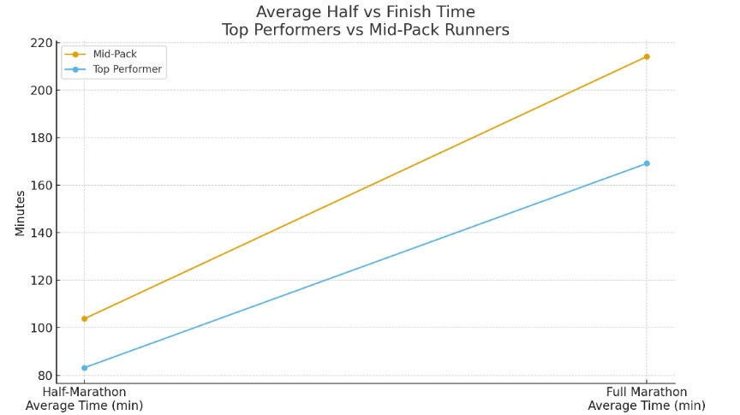
Performance-Based Pacing Strategy
Pacing ratio = Full Marathon Time ÷ Half-Marathon Time
Top performers slow less → more efficient pacing
Mid-pack pace drop shown by steeper line

Slide 9
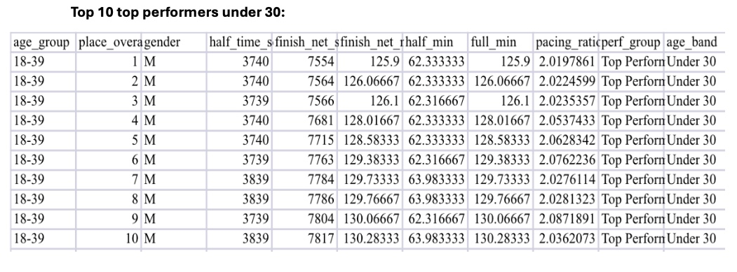
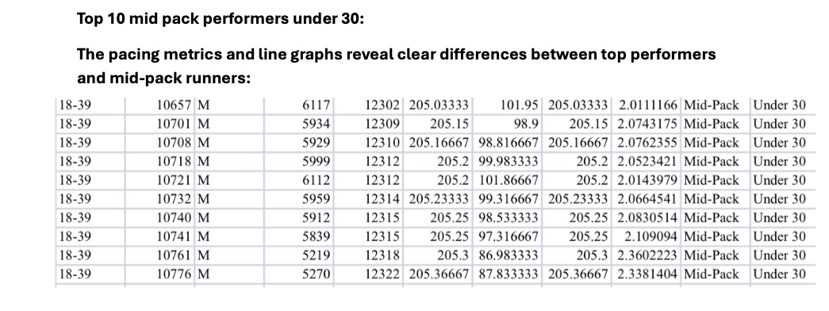
Example Pacing Differences: Under-30 Runners
Both are young, but performance differences still show stronger pacing in top group
Reinforces pacing efficiency isn’t just age-related

Slide 10
Summary of Pacing Ratio Analysis
Top performers: pacing ratio ≈ 2.0 → consistent pacing
Mid-pack: pacing ratio > 2.0 → more slowdown
Gender differences minimal
Slight fatigue increase in older runners
Performance level is the strongest pacing predictor

